Slide 1


Multi-Beam Design for Extremely Large-Scale RIS Aided Near-Field Wireless Communications
Decai Shen, Linglong Dai
Department of Electronic Engineering
Tsinghua University
December, 2022

Slide 2
Background
Proposed solution
Simulation results
Conclusions

Slide 3
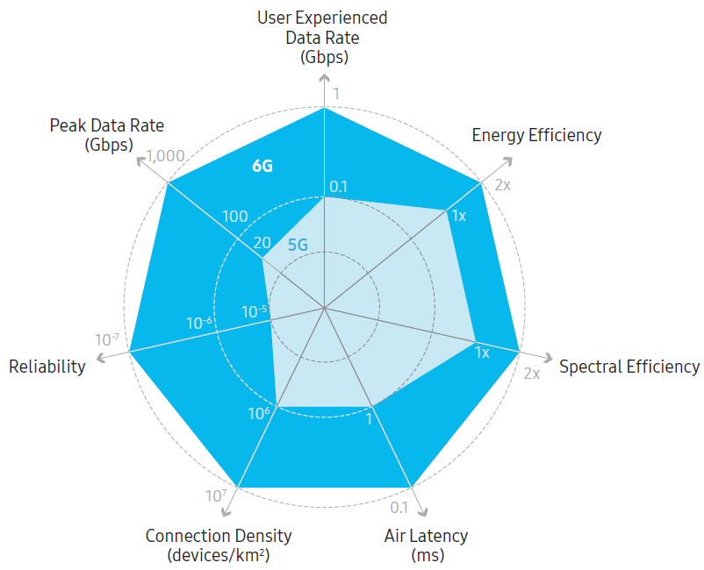

Background
Key performance requirements for 6G communication
  2x of increase in energy efficiency
  100x of increase in reliability
Samsung, “6G The next hyper——Connected experience for all,” Jul. 2020.

Slide 4

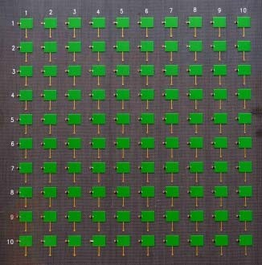
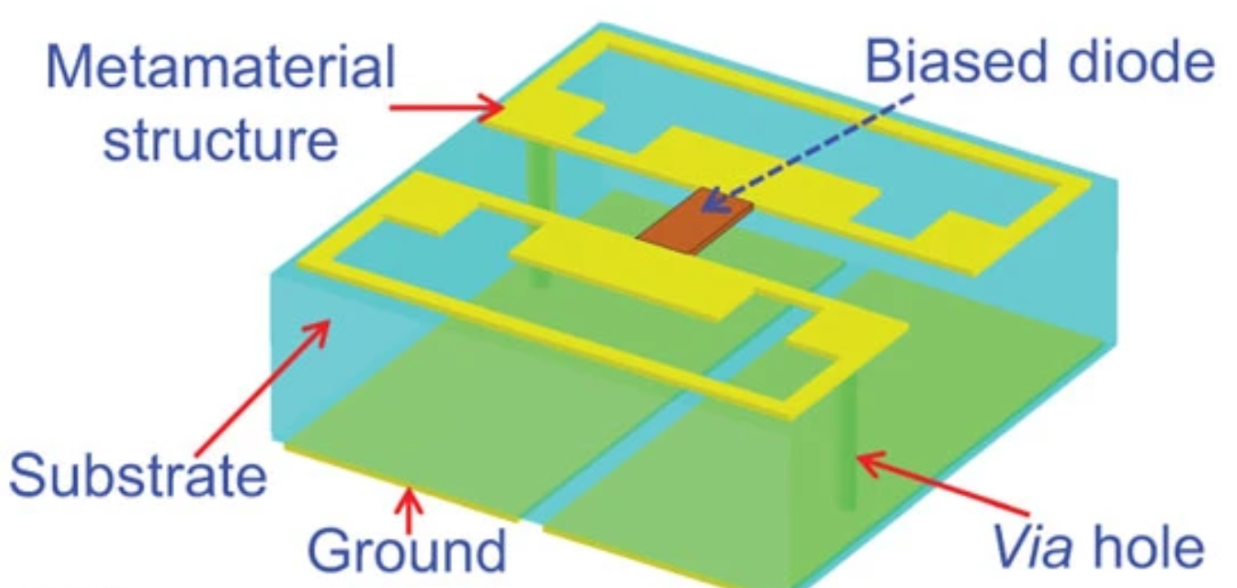
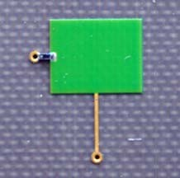
Background
Reconfigurable Intelligent Surface, RIS
  A surface of reconfigurable metamaterial
  Intelligently control the propagation of electromagnetic wave
  Manipulate the channel to improve the quality of the signal
  From RIS to XL-RIS (extremely large-scale RIS)
PIN diode
[1] T. Cui, M. Qi, X. Wan, J. Zhao, and Q. Cheng, “Coding metamaterials, digital metamaterials and programmable metamaterials,” Light:
Science & Applications, vol. 3, p. e218, Oct. 2014.
[3] H. Yang, X. Cao, F. Yang, J. Gao, S. Xu, M. Li, X. Chen, Y. Zhao, Y. Zheng, and S. Li, “A programmable metasurface with dynamic
polarization, scattering and focusing control,” Scientific Reports, vol. 6, p. 35692 EP, Oct. 2016.

Slide 5
Background
RIS vs. Massive MIMO
 | Massive MIMO | RIS
System Architecture
Beamforming | Yes | Yes
RF Chain | Yes | No
Energy Consumption | High | Negligible
CSI Acquisition | Normal | Complicated
micro controller

Slide 6
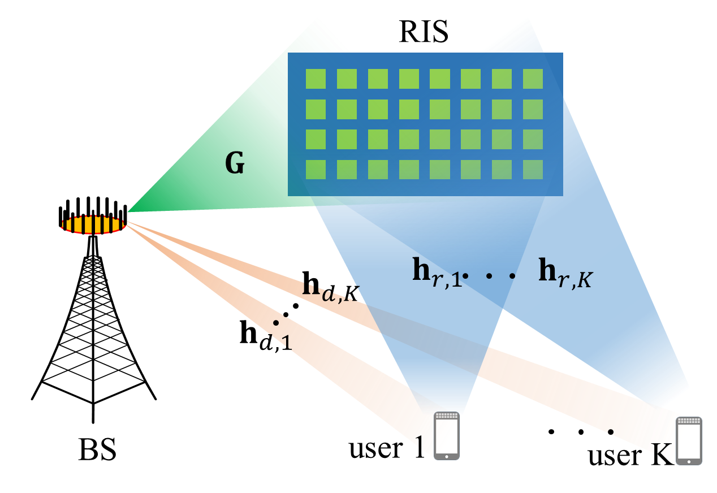
Channel Estimation v.s. Beam Training
The main challenge for RIS channel estimation
  Without the deployment of RF chain, RIS can not receive/transmit the pilot
  To design the RIS beamforming, it is essential to estimate the CSI for cascaded channel with pretty high overhead
Beam training (BT): An effective alternative
  It is effective to directly determine the beam design with a pre-designed codebook via beam training
Improve times
(e.g., RIS 256 elements)
Unaffordable overhead
Without RIS
With RIS

Slide 7
Multi-Beam Design
Single-beam design
  Most of the beam design scheme is single-beam design for one UE
  A codeword is selected from the codebook to represent the RIS beamforming (BF) with maximal beam gain^{[1]}
Multi-beam design
  Directly superpose the codewords for all UEs as a BF vector is unsatisfied
  Challenge: constant modulus constraint for RIS elements
  RIS can only adjust the phase rather than the amplitude
RIS
Phase shift
RIS
Reflecting
Signal
Incident
Signal
[1] X. Wei, L. Dai, Y. Zhao, G. Yu, X. Duan, and X. Wang, “Codebook design and beam training for extremely large-scale RIS: Far-field or near-field?” China Commun., vol. 19, no. 6, pp. 193–204, Jun. 2022.

Slide 8











Multi-Beam Design
Multi-beam design
  Due to the constant modulus constraint, the effective directions of the superposed vector will deviate and the beam gain will decrease
BS
RIS
deviation
5 dB
$$w_{4}$$
$$w_{3}$$
$$w_{2}$$
$$w_{1}$$
$w_{1}$：Codeword for UE1
$w_{2}$：Codeword for UE2
$w_{3}$： Codeword for UE3
$w_{4}$： Codeword for UE4
$w$： Superposed BF vector
$$w=e^{j∠(w_{1}+w_{2}+w_{3}+w_{4})}$$

Slide 9
Background
Proposed solution
Simulation results
Conclusions

Slide 10
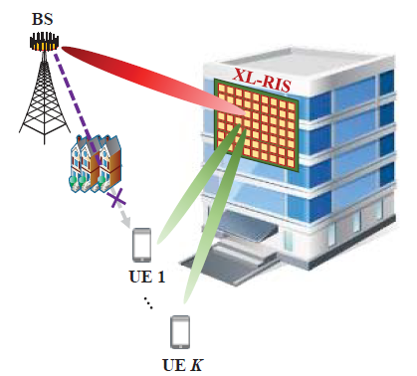
System Model
System model
  One base station (BS) with M antennas is aided by an RIS with N elements to simultaneously serve K single-antenna users (UEs)
  We adopt the assumption that the direct BS-UE transmission link is blocked by the obstacles
  For high-frequency transmission, only the line-of-sight (LoS) path from the XL-RIS to the BS or UEs is considered

Slide 11
System Model
Signal model
  The received signal for the k-th user
  represents the reflecting diagonal matrix, and the n-th element can be expressed as (constant modulus constraint)
  The received signal can be rewritten as
Channel model
  The downlink cascaded channel for the k-th user

Slide 12
System Model
Far-field channel model
  The BS-RIS channel
  With the steering vector
  Similarly, the RIS-UE channel
  The positions for the BS and RIS are fixed, assume that the BS precoding has been designed to point to RIS as . Thus, the effective reflecting channel for the far-field can be rewritten as

Slide 13
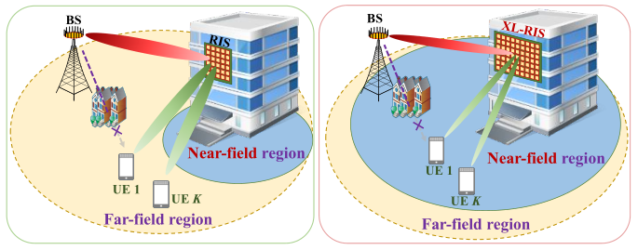
System Model
Near-field channel model
  With the enlargement of aperture, more UEs will locate in the near-field region^{[1]}
  Similar to the effective far-field channel , the effective far-field channel
  With the steering vector^{[2]}
  denote the distance from element of RIS to the k-th UE
[1] M. Cui, Z. Wu, Y. Lu, X. Wei, and L. Dai, “Near-field communications for 6G: Fundamentals, challenges, potentials, and future directions,” arXiv preprint arXiv:2203.16318, Mar. 2022.
[2] X. Wei, L. Dai, Y. Zhao, G. Yu, X. Duan, and X. Wang, “Codebook design and beam training for extremely large-scale RIS: Far-field or near-field?” China Commun., vol. 19, no. 6, pp. 193–204, Jun. 2022.

Slide 14
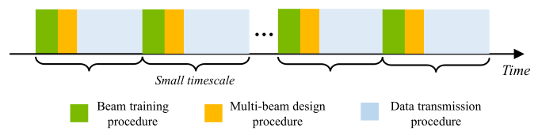
Proposed framework
The proposed framework
  Composed of a beam training procedure and a multi-beam design procedure
  Beam training procedure is carried out by all UEs independently, the codeword
  for every UE is selected by this procedure as
  Multi-beam design procedure is the core procedure of this framework

Slide 15
Problem formulation
Multi-beam design procedure
  The aim of the procedure is to generate the near-field multi-beams pointing to the desired UEs with the desired gains.
  The amplitude of , i.e., represents the desired beam gains
  The k columns of are the k codewords for UEs
  is the RIS beamforming vector

Slide 16
Proposed framework
Multi-beam design procedure
  Propose a block coordinate descent (BCD) based scheme with majorization-minimization (MM) algorithm
  To deal with the constant modulus constraint
  1.Decompose intractable problem to a series of sub-problems with MM algor.
  2.Introduce the phase factors for multi-beam gains as extra optimizable variables
  3.Alternately optimize the above two parameters with the BCD strategy
BCD

Slide 17
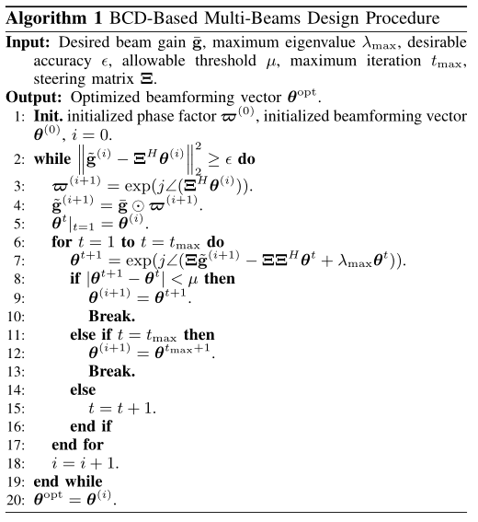
Proposed framework
Multi-beam design procedure
  Parameters acquire by beam training procedure
  The optimization for
  The optimization for RIS beamforming with MM.
  The joint optimization for and with BCD strategy.

Slide 18
Background
Proposed solution
Simulation results
Conclusions

Slide 19
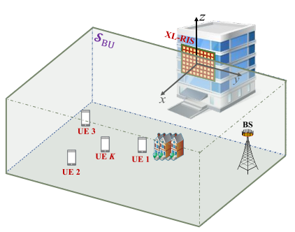
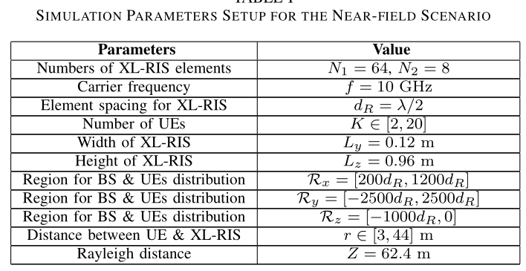
Simulation Setup
Simulation scenario and simulation parameters

Slide 20
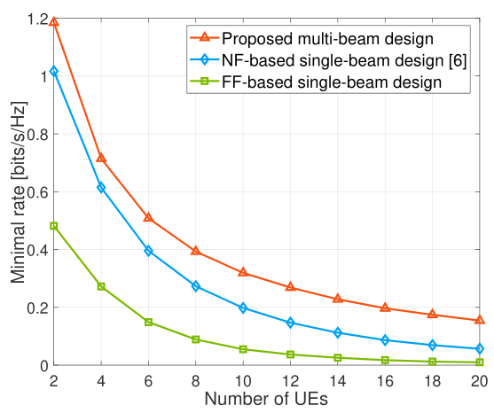
Simulation Results
Minimal rate performance comparison against the number of UEs.
  The minimal rate of proposed scheme is 80% higher than the baselines
X. Wei, L. Dai, Y. Zhao, G. Yu, X. Duan, and X. Wang, “Codebook design and beam training for extremely large-scale RIS: Far-field or near-field?” China Commun., vol. 19, no. 6, pp. 193–204, Jun. 2022.

Slide 21
Background
Proposed solution
Simulation results
Conclusions

Slide 22
Conclusions
Extremely Large-Scale RIS
  With the enlargement of RIS array aperture, the accurate acquisition for is pretty difficult, and it is effective to directly determine the near-field beam design with a codebook via beam training
  Limited by the constant modulus constraint, many existing works for the beam design based on the codebook training scheme in the near-field focus on the single-UE case in RIS-aided wireless communications
Proposed scheme
  Composed of a beam training procedure and a multi-beam design procedure
  A block coordinate descent (BCD) based scheme with the majorization-minimization (MM) algorithm to achieve the multi-beam design procedure
  The proposed scheme can achieve better minimal rate both in the near-field and far-field scenario

Slide 23
Reference
S. Ma, W. Shen, J. An, and L. Hanzo, “Wideband channel estimation for IRS-aided systems in the face of beam squint,” IEEE Trans. Wireless Commun., vol. 20, no. 10, pp. 6240–6253, Oct. 2021.
S. Liu, Z. Gao, J. Zhang, M. D. Renzo, and M.-S. Alouini, “Deep denoising neural network assisted compressive channel estimation for mmWave intelligent reflecting surfaces,” IEEE Trans. Veh. Technol., vol. 69, no. 8, pp. 9223–9228, Aug. 2020.
H. Sun, S. Zhang, J. Ma, and O. A. Dobre, “Path loss of RIS-aided spatial modulation with on/off pattern,” IEEE Commun. Lett., vol. 26, no. 4, pp. 937–941, Apr. 2022.
M. Cui, Z. Wu, Y. Lu, X. Wei, and L. Dai, “Near-field communications for 6G: Fundamentals, challenges, potentials, and future directions,” arXiv preprint arXiv:2203.16318, Mar. 2022.
C. Feng, W. Shen, J. An, and L. Hanzo, “Joint hybrid and passive RIS-assisted beamforming for mmWave MIMO systems relying on dynamically configured subarrays,” IEEE Internet Things J., pp. 1–1, Jan. 2022.
G. Alexandropoulos, V. Jamali, R. Schober, and V. Poor, “Near-field hierarchical beam management for RIS-enabled millimeter wave multi-antenna systems,” arXiv preprint arXiv:2203.15557, Mar. 2022.
Y. Sun, P. Babu, and D. P. Palomar, “Majorization-minimization algorithms in signal processing, communications, and machine learning,” IEEE Trans. Signal Process., vol. 65, no. 3, pp. 794–816, Feb. 2017.

Slide 24
Thank you
Multi-Beam Design for Extremely Large-Scale RIS Aided Near-Field Wireless Communications
Decai Shen, Linglong Dai
December, 2022
E-mail: sdc18@mails.tsinghua.edu.cn
Website: http://oa.ee.tsinghua.edu.cn/dailinglong/

